Slide 1

Schrat
Ein Labyrinth Puzzle Spiel
Pascal Felber, Sebastian Riedi 2017

Slide 2
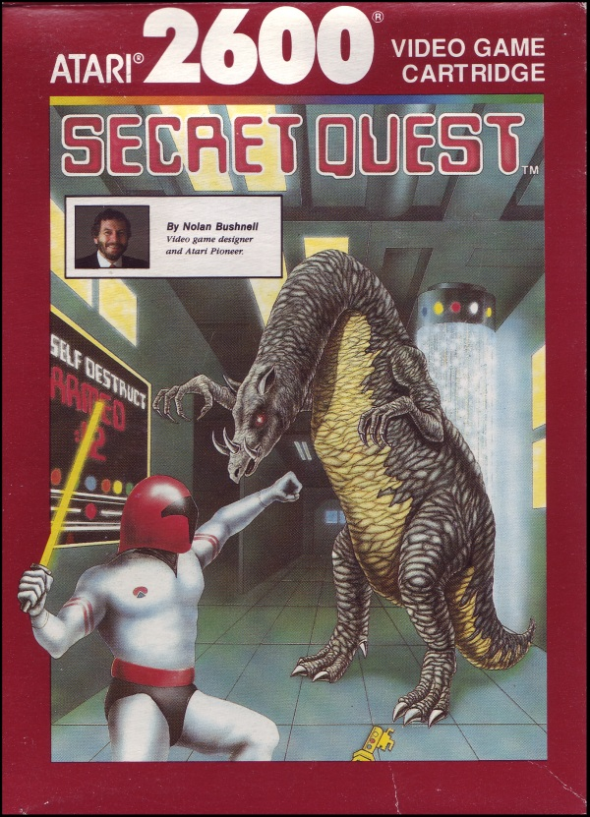
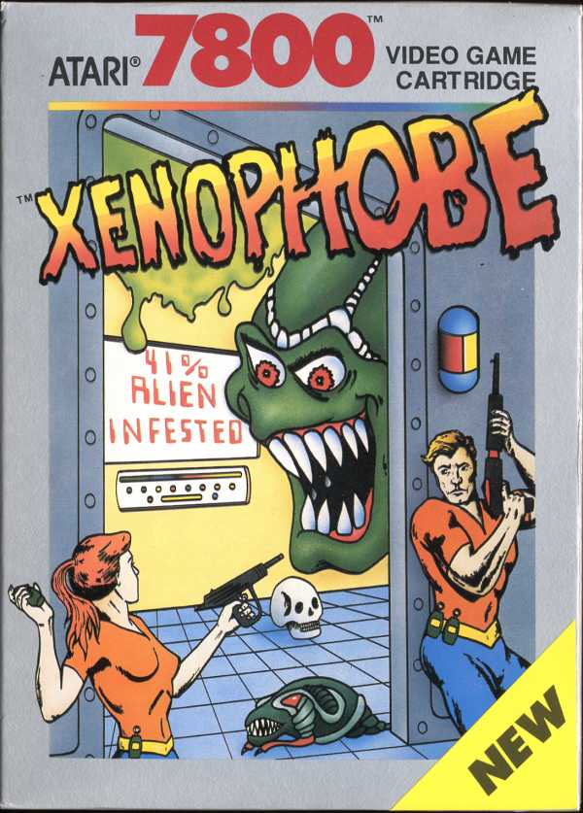
Basic Concepts
Inspiration

Slide 3
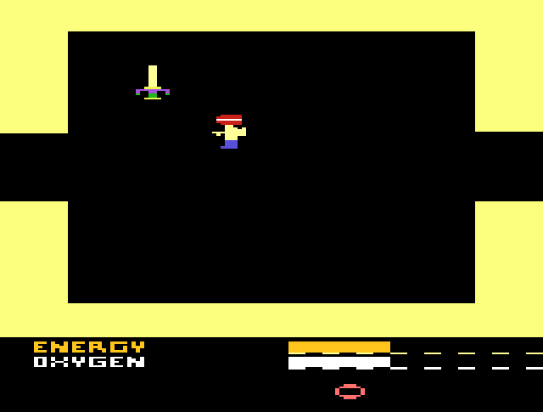
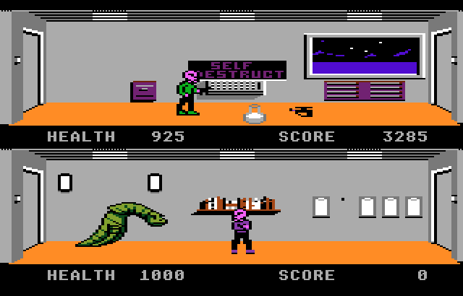
Basic Concepts
Secret Quest (Atari 2600)
Xenophobe (Atari 7800)
Labyrinth
Orienteering
Limited Player Resources (Oxygen)
Enemy development
Character Visuals
Fluent Animations

Slide 4
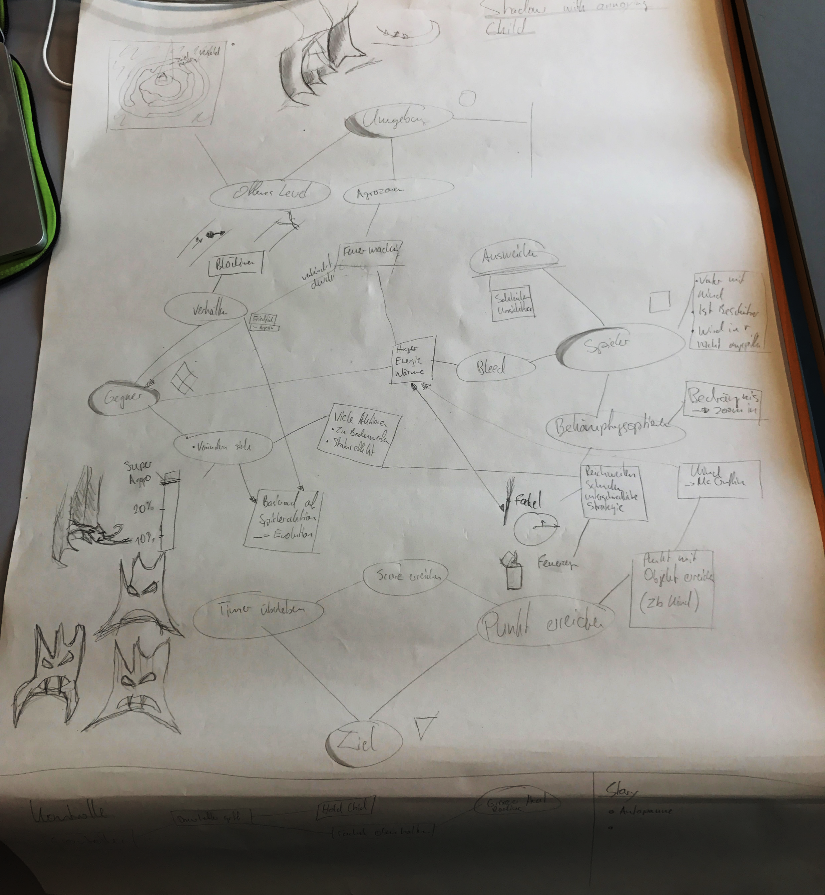
Mechanics Process
Connecting the Different Mechanics between the Poles of the Game
Also some random doodling…

Slide 5
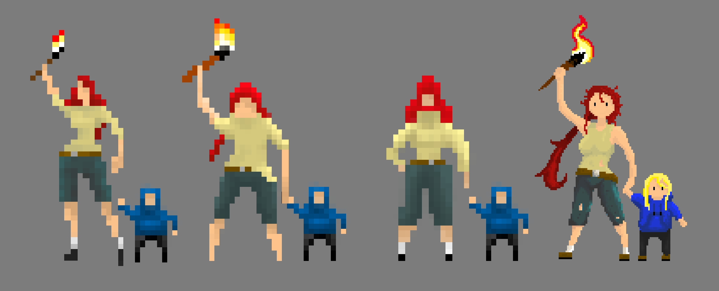
Game Visuals
Characters
Increasing Pixel deduction

Slide 6
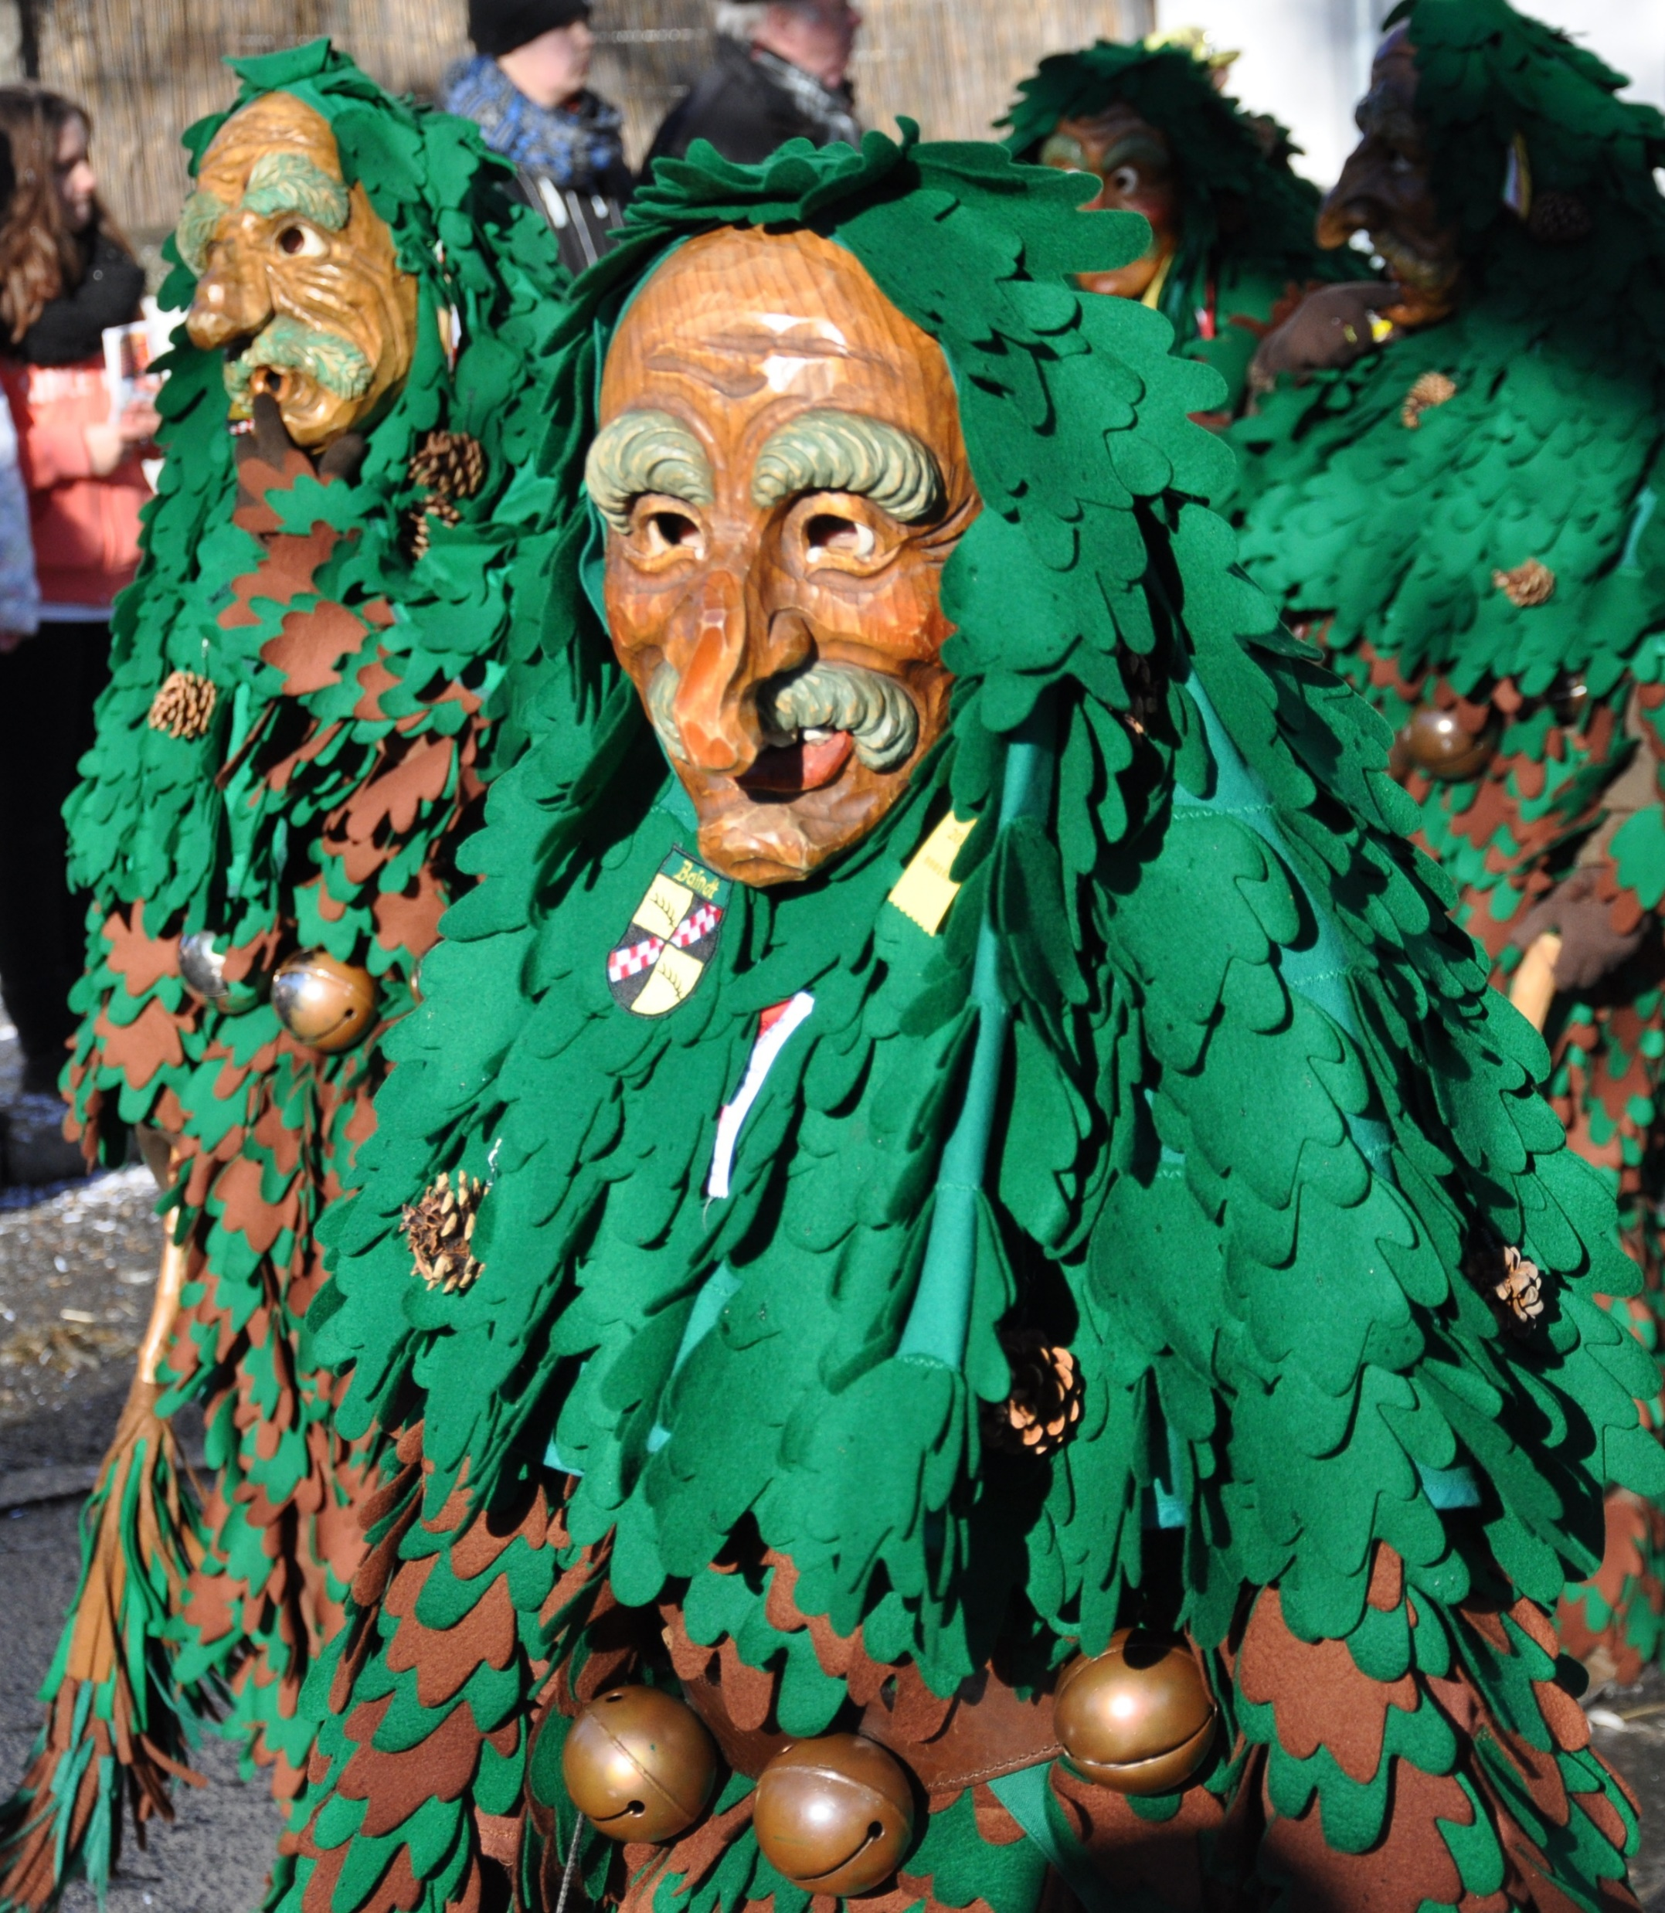
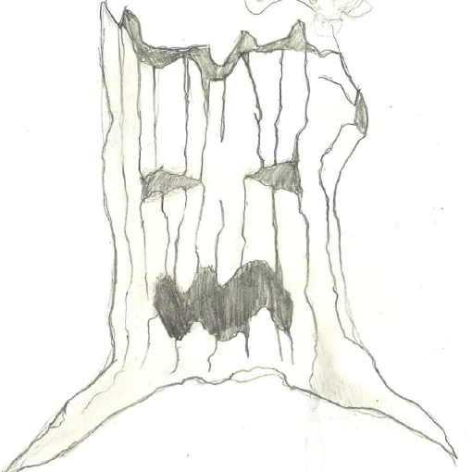
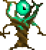
Game Visuals
Enemy Design and Inspiration

Slide 7
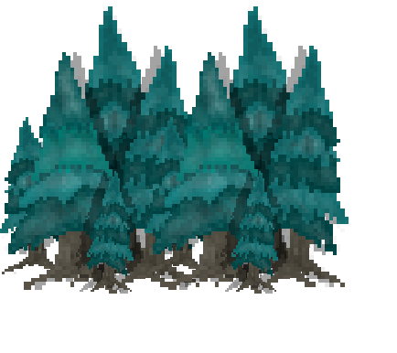
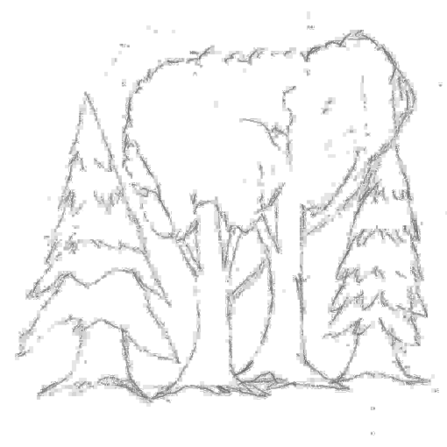
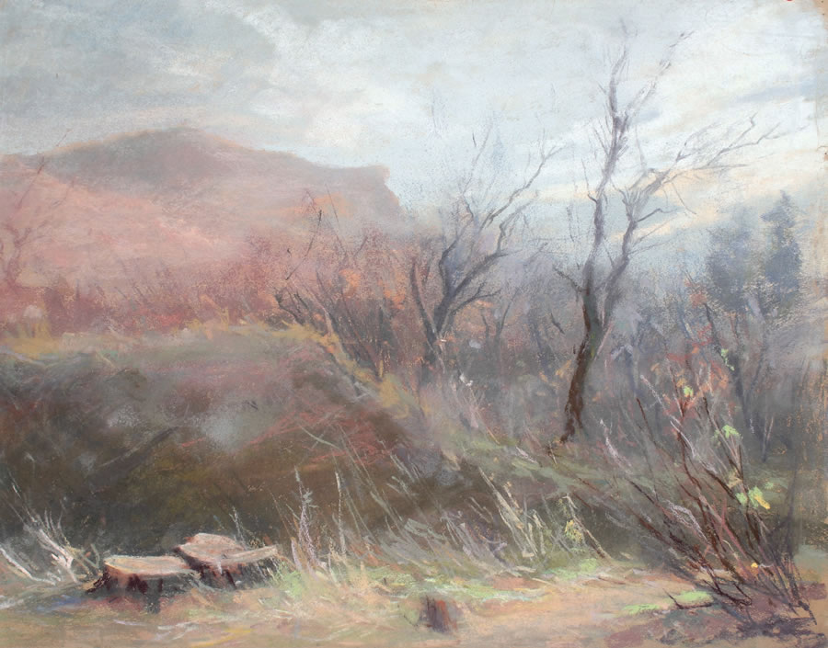
Game Visuals
Cold Surroundings
Cold Color Shades
Pastell Look

Slide 8
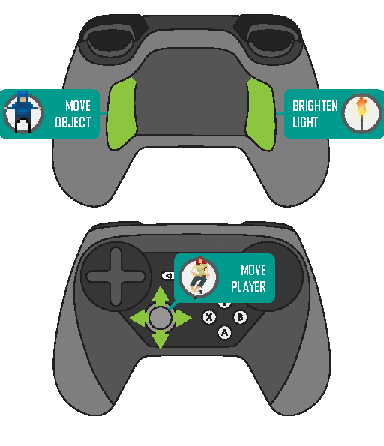
Controls & Stess
Physical Stress
Grip-Buttons of the Steam Controller
Feel of a Chase
Extortion

Slide 9

Let’s play

